Slide 1

AFRI TECH LTD.
Brand Reputation Enhancement Dashboard Analysis
BUSINESS PERFORMANCE ANALYSIS
Revenue Growth
Year-over-Year Analysis
Customer Segmentation
VIP, Returning & New
Regional Performance
Top 5 Revenue Centers
$57.53M
TOTAL REVENUE
$30.83M
PREV. YEAR
61.13K
AVERAGE INCOME
200
TOTAL CUSTOMERS
REVENUE
86.5% YoY Growth in Total Revenue
AFRI TECH LTD.
F^{M}in^{ad}a^{e}n^{w}ci^{i}a^{th}l Y^{G}e^{e}a^{n}r^{sp}2ª0^{r}2^{k}3

Slide 2

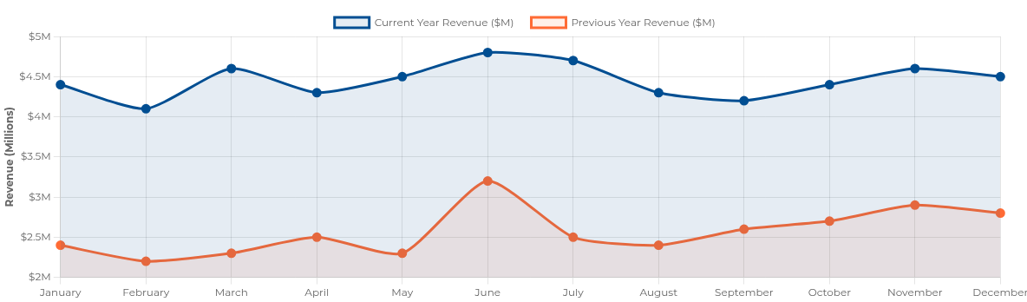
$57.53M
Current Year Revenue
YEAR- OVER-YEAR PERFORMANCE
Revenue Growth Analysis
$30.83M
Previous Year Revenue
+86.5%
Year-over-Year Growth
Key Insights
Growth Drivers
Consistent growth pattern throughout the year with peak performance in June
Laptop division led growth with 92% increase ($25M vs $13M)
New customer acquisition contributing 48.54% of total revenue
Current year revenue outperformed previous year every month
Geographic expansion in West Virginia and Nebraska
Q2 showed the highest growth rate at 92% YoY
AFRI TECH LTD.
Made with Genspark
Slide 2 of 6

Slide 3

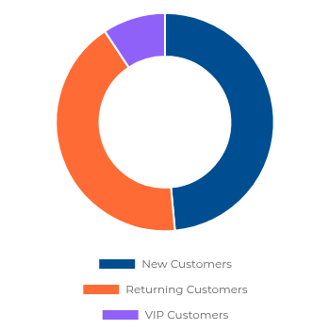

Customer Segmentation
CUSTOMER ANALYSIS
Revenue by Customer Type
New Customers
48.54%
Largest revenue segment at $27.93M
Strong customer acquisition driving growth Opportunity to convert to returning customers
Returning Customers 42.14% Strong loyalty base at $24.25M
Indicates healthy product satisfaction Loyalty programs could increase retention
VIP Customers
9.31%
High-value segment at $5.36M
Smallest segment with growth potential VIP program expansion recommended
Strategic Recommendations
Implement targeted loyalty program to convert new customers to returning
$27.93M
New Customers
$24.25M
Returning Customers
$5.36M
VIP Customers
Create VIP tier benefits to increase high-value segment
Focus marketing on regions with highest new customer acquisition

Slide 4

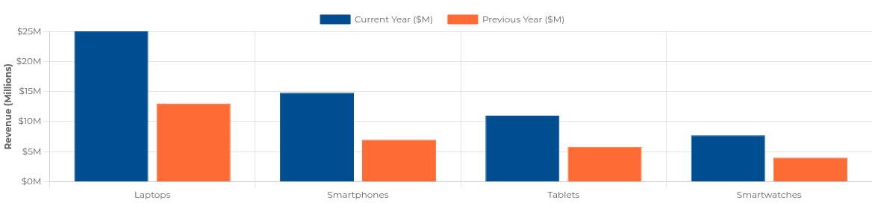

Product Performance
PRODUCT ANALYSIS
Revenue by Product Category
Laptops
Smartphones
Tablets
Smartwatches
$38.00M
$21.81M
$16.81M
$11.74M
+92%
+111%
+89%
+94%
Current: $25M | Previous: $13M
Current: $14.81M | Previous: $7M
Current: $11M | Previous: $5.81M
Current: $7.74M | Previous: $4M
Top performing product line
Highest growth percentage
Popular with returning customers
Emerging market opportunity
Strategic Insights & Recommendations
All product lines show >85% YoY growth, with smartphones leading at 111%
Expand laptop inventory in top regions (WV, NE) to capitalize on demand
Laptop division contributes 38% of total revenue - prioritize marketing
Develop smartwatch cross-selling strategy for smartphone customers

Slide 5

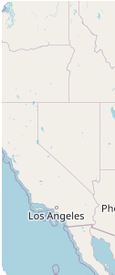
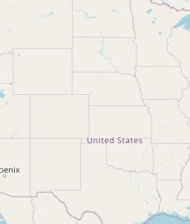


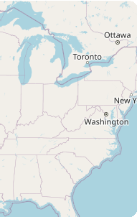
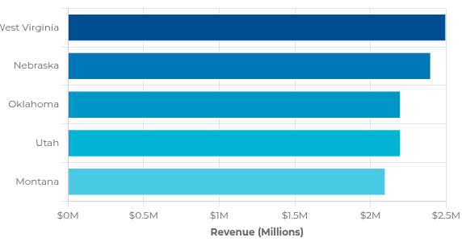




Regional Performance
GEOGRAPHIC ANALYSIS
Top Performing Regions
Revenue by Region
+
−
Leaflet | © OpenStreetMap contributors
Strategic Recommendations
Regional Insights
Expand operations in West Virginia and Nebraska to capitalize on strong performance
Midwest & Western regions drive 80% of revenue
West Virginia leads with $2.5M in sales
Open flagship stores in Oklahoma and Utah to enhance brand presence
Oklahoma showing fastest growth rate
Untapped potential in Eastern regions
Partner with regional retailers in Montana to increase market penetration
AFRI TECH LTD.
Made with Genspark
Slide 5 of 6

Slide 6








Summary & Strategic Recommendations
KEY FINDINGS & STRATEGIC DIRECTION
Performance Highlights
Strategic Imperatives
86.5% YoY Revenue Growth
from $30.83M to $57.53M
Product Strategy
Expand laptop product line while growing smartphone division to capitalize on highest growth rate
Customer Strategy Implement loyalty program to convert new customers to returning; develop VIP customer initiatives
Product Performance
Laptops lead with $38M revenue (38% of total)
Customer Segmentation
48.5% revenue from new customers ($27.93M)
Regional Strategy
Expand operations in West Virginia and Nebraska; target Eastern regions for market expansion
Market Positioning Leverage brand reputation for premium tech products in emerging markets
Regional Success
West Virginia leads with $2.5M in sales
Implementation Roadmap
Short-Term (Q1-Q2) Launch customer loyalty program Expand laptop inventory in top regions
Mid-Term (Q3-Q4)
Open flagship stores in Oklahoma & Utah Launch VIP customer incentive program
Long-Term (FY 2024) Expand into Eastern market regions Develop integrated product ecosystem
With continued strategic execution, AFRI TECH LTD. is positioned to achieve $100M+ revenue target by FY 2024
AFRI TECH LTD.
Made with Genspark
Slide 6 of 6

